Slide 1
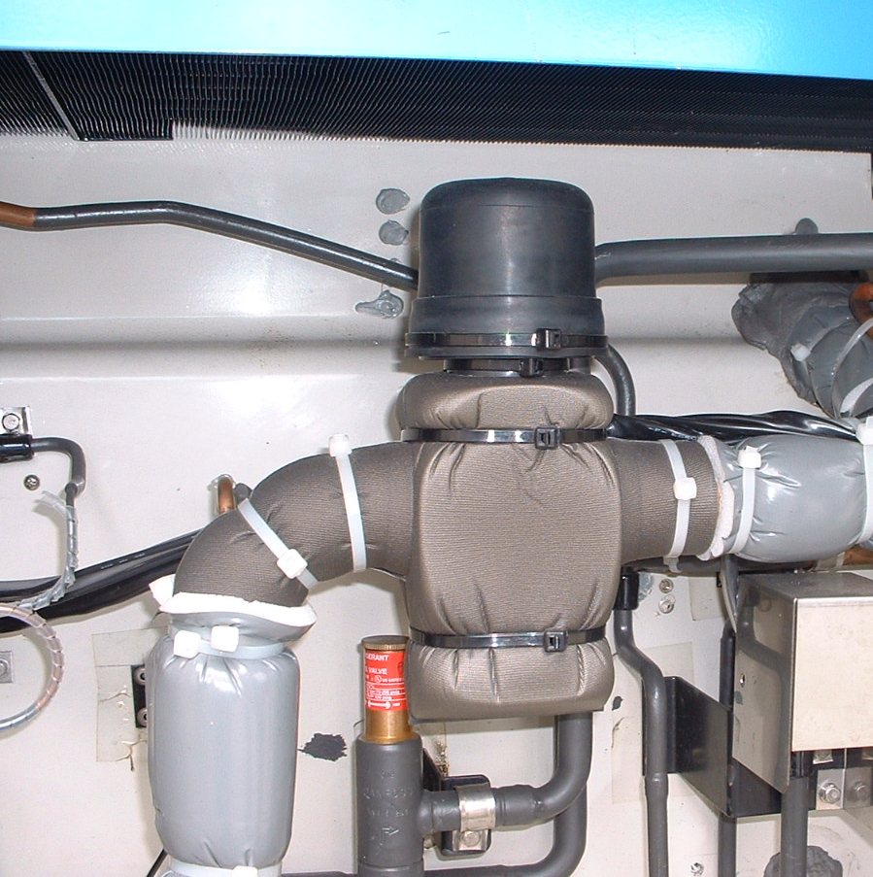
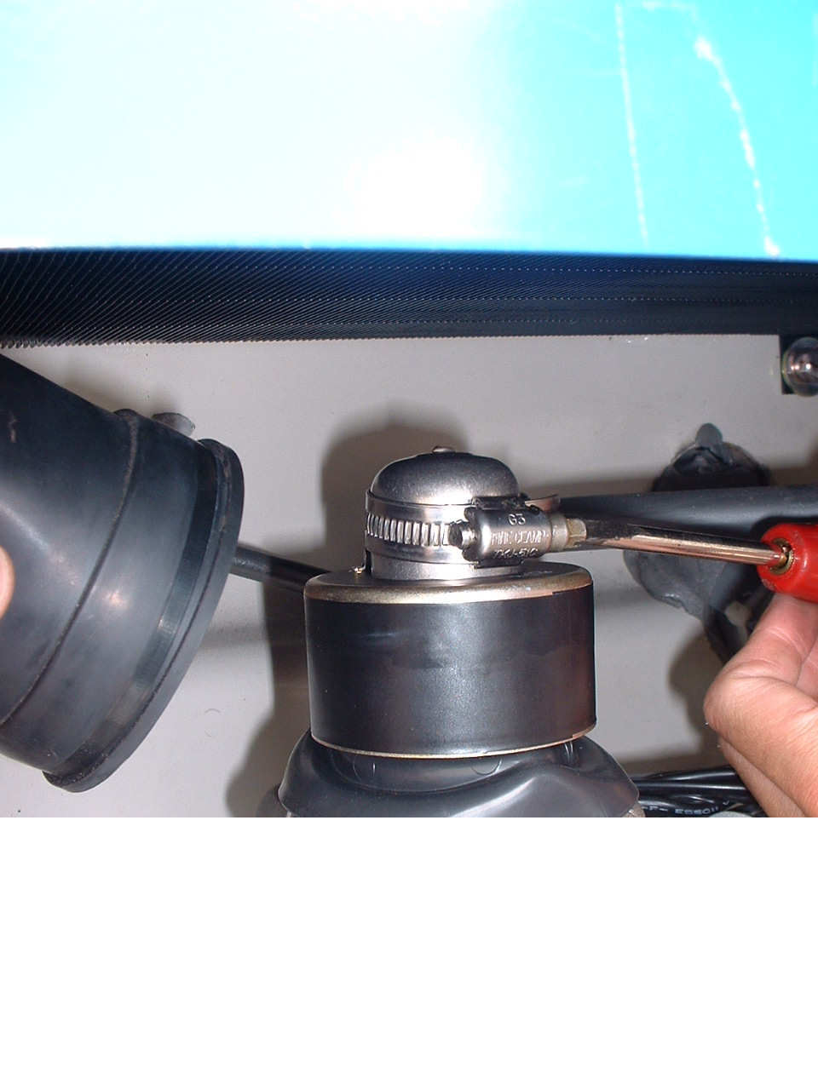
Step 3 : Setting of Suction modulating valve
Ｓｔｅｐ 3-1 Cut clamps and remove the coil
Clamps

Slide 2
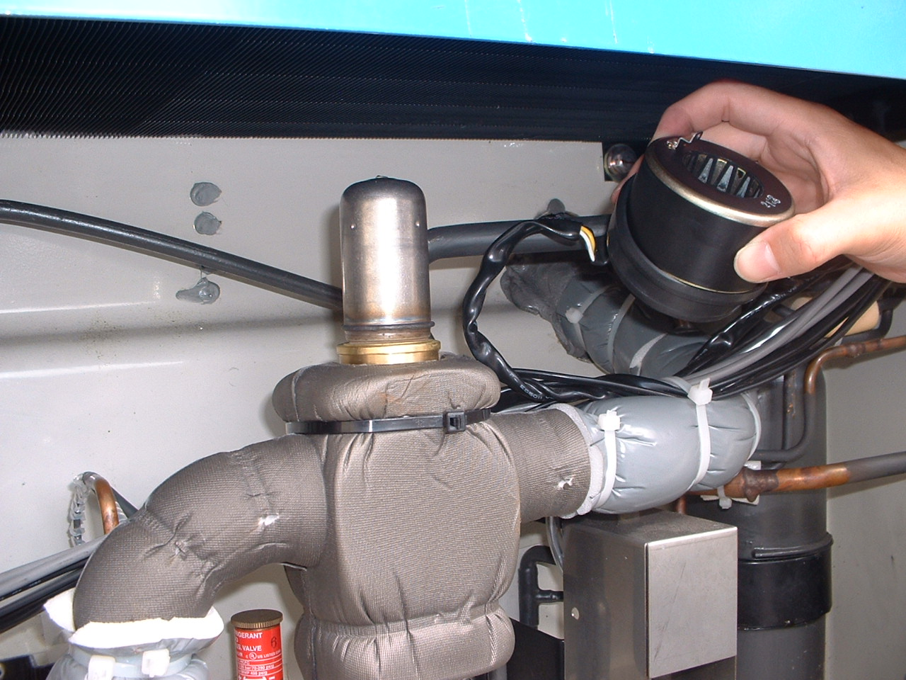

Slide 3
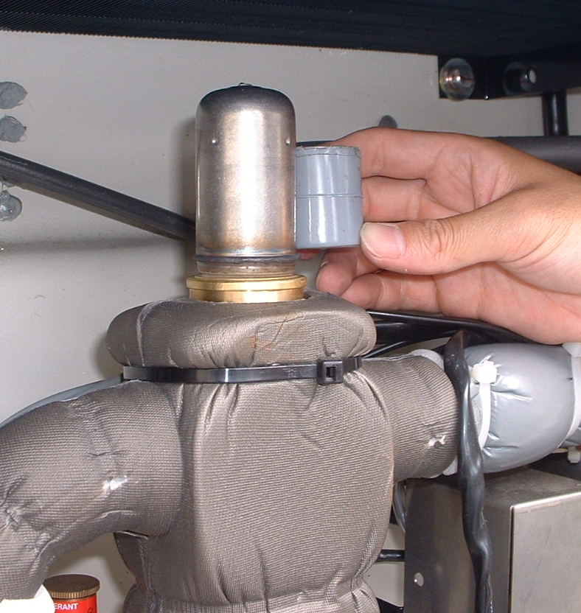
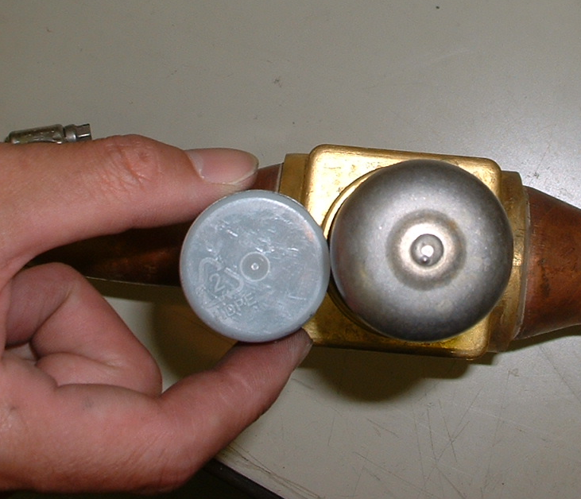
Ｓｔｅｐ 3-2
Contact the Emergency magnet to the mounting of coil and open SMV fully by circulating of magnet
UPSIDE
DOWNSI
*Emergency magnet is in onboard spare parts kit

Slide 4
Ｓｔｅｐ 3-3
When SMV open fully, magnet cannot rotate around the mounting of SMV coil.

Slide 5
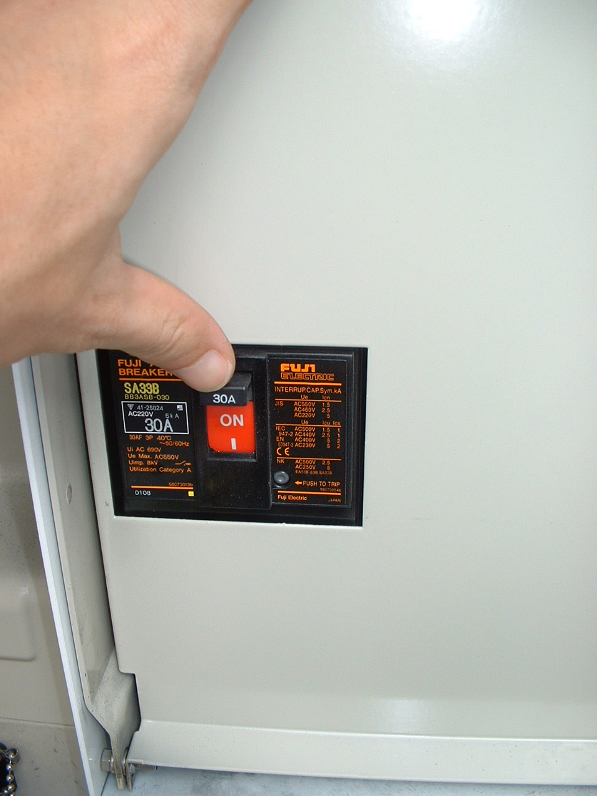
Ｓｔｅｐ 3-4 Turn ON the circuit breaker to start

